Slide 1
CONTENTS
Trend Insights
Top Trending Post
Trending keyword
Sentiment
Geographic Analysis
Demographic Analysis
Brand Mentions
Flavour Insights
Top Themes
Themes Sov
Key Drivers
Methodology
Summary
Conclusion

Slide 2
Trend Insights: monthly basis

Slide 3
Trend Insights: daily basis

Slide 4
Top Trending Post
Post Headline | Impression | Reach | Likes | Shares | Comments
The food industry narrative - Want fibre? Eat oats. Polyphenols? Drink green tea. | 1249617.6 | 757344 | 794 | 134 | 30
#IncredibleIndia’s hospitality & culture is a sight to behold everywhere I go. | 1378792.8 | 835632 | 307 | 50 | 3
Hi how u all doing 😉👋 Clicks after a Green Tea | 556688.55 | 337387 | 1328 | 53 | 38
🍵 Introducing the Finest Japanese Green Tea Collection, Exclusively by Kyoto Beverages 🍵 | 29767.65 | 18041 | 1148 | 90 | 5
Green Tea Benefits: ग्रीन टी के फायदे, ग्रीन टी पीने का सही समय और सही तरीका | 115701.3 | 70122 | 336 | 317 | 9
Everyday I do meditate for 30 mins least, have cold shower… consume green tea sometimes | 182016.45 | 110313 | 447 | 20 | 35
Green tea can help you lose weight. If you climb up everyday to the top of mountain… | 53649.75 | 32515 | 391 | 7 | 7

Slide 5
Top Trending Post (Contd…)
Post Headline | Impression | Reach | Likes | Shares | Comments
The food industry narrative - Want fibre? Eat oats. Polyphenols? Drink green tea. | 1249617.6 | 757344 | 794 | 134 | 30
#IncredibleIndia’s hospitality & culture is a sight to behold everywhere I go. | 1378792.8 | 835632 | 307 | 50 | 3
Hi how u all doing 😉👋 Clicks after a Green Tea | 556688.55 | 337387 | 1328 | 53 | 38
🍵 Introducing the Finest Japanese Green Tea Collection, Exclusively by Kyoto Beverages 🍵 | 29767.65 | 18041 | 1148 | 90 | 5
Green Tea Benefits: ग्रीन टी के फायदे, ग्रीन टी पीने का सही समय और सही तरीका | 115701.3 | 70122 | 336 | 317 | 9
Everyday I do meditate for 30 mins least, have cold shower… consume green tea sometimes | 182016.45 | 110313 | 447 | 20 | 35
Green tea can help you lose weight. If you climb up everyday to the top of mountain… | 53649.75 | 32515 | 391 | 7 | 7

Slide 6
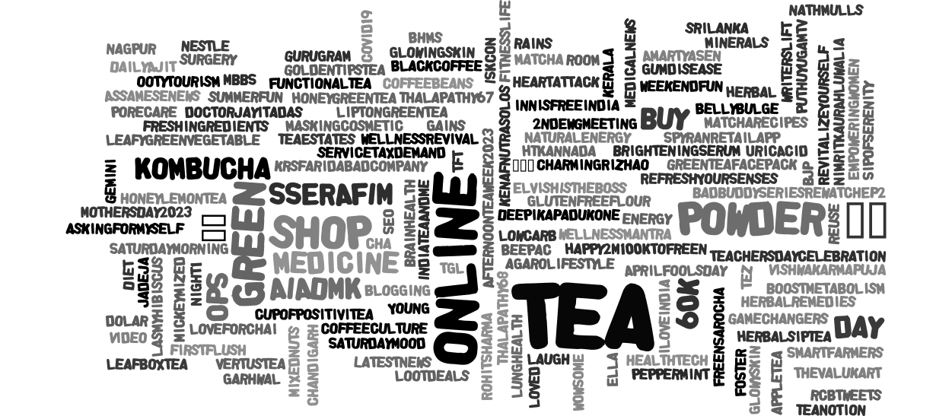
Trending keywords

Slide 7
Sentiment: Overall

Slide 8
Sentiment: Monthly basis
On 21st May, it was observed as International Tea Day(75 post) which led to raise in positive sentiment
June 10th was observed as highest neutral sentiment and 29th September was observed as least neutral sentiment.
On May 30, influencer posted related to weight loss scam (17 post) which led to raise in negative sentiment

Slide 9
Sentiment: Daily basis for April

Slide 10
Sentiment: Daily basis for May

Slide 11
Sentiment: Daily basis for June

Slide 12
Sentiment: Daily basis for July

Slide 13
Sentiment: Daily basis for August

Slide 14
Sentiment: Daily basis for September

Slide 15
Brand mentions

Slide 16
Geographic Analysis
Country | Users Count
India | 7764
Thailand | 10
USA | 3
England | 2
United Arab Emirates | 2
Singapore | 1
Japan | 1
France | 1
Canada | 1
Australia | 1
Cities | Users Count
New Delhi | 774
Mumbai | 540
Bangalore | 297
Hyderabad | 283
Jaipur | 199
Chennai | 196
Kolkata | 162
Greater Noida | 109
Pune | 100
Lucknow | 67
Uttar Pradesh | 65
Rajasthan | 56
Chandigarh | 55
Gurgaon | 54
Indore | 50

Slide 17
Demographic Analysis

Slide 18
Brand Mentions

Slide 19
Brands
Leafbox: It’s of wholesome blends, comprising finest tea and wondrous natural ingredients, with excellent antioxidant and medicinal properties.
Tetley: Tetley is an English beverage manufacturer founded in 1837 in Yorkshire. It is the largest company of tea in the United Kingdom and Canada, and the second largest in the United States by volume.
Dolshyne: Unique flavors and aromatic blends are carefully curated to support an active and wholesome lifestyle.
Kasika: Indulge in the goodness of natural and refreshing flavors with Kasika Tea's wide range of green and herbal teas.
Lipton: Lipton is a British-American brand of tea, soup, and dipping sauce, owned by Lipton Teas and Infusions.
Kangra: Organic, handcrafted green teas are not just a drink, they are a way of life.
Symphony: Symphony Pure Natural Green Tea is an all-natural, high-quality blend of green tea leaves
MSG: Offer a wide range of fresh produce, pantry essentials, and specialty items.
Khadi: 100% natural detox and healthy weight practice with a cup of GREEN TEA.
Apis : Apis brings the most authentic taste with the perfect texture.
Tea Sense: Get teas from the best tea gardens and blend them to give you a consistent taste and aroma though out the year
Taj: Cocooned in a charming, old-worldly lane in Bandra, Mumbai, Brooke Bond Taj Mahal Tea House, appeals to tea connoisseurs, classical live music enthusiasts, book lovers, and many an artistic soul.
Deroi tea: Deroi Tea is a combination of flavoured aroma with strength.
Ichitan: Ichitan Group Co., Ltd. is a Thai beverage company that manufactures green tea drinks, herbal drinks, fruit drinks, and energy drinks.
Spoorthy: Spoothy organic herbal green tea is made using tulsi green tea, spearmint tea, guava leaf tea, moringa leaves, stevia herb, bel green tea leaves.
KRS: Established in the year 2018, KRS Multipro Private limited is a part of KRS Group of Companies lead & nurtured by the great visionary & philanthropist “DR. JAI PRAKASH TYAGI.”
Dalmia: Dalmia Gold Tea is the best tea brand in India. It is the trusted tea company pioneering in blending and packaging of tea.
Namsesu: Namsesu presents Organic tea from Assam, deals in Assam Black Tea, Green Tea, Blue Tea.
Lasmy: Strive to provide a truly exceptional tea experience that will tantalize your taste buds and soothe your senses.

Slide 20
Flavours Insights

Slide 21
Flavours Merit and barrier
Darjeeling tea brews contain flavonoids or phytonutrient-rich plant pigments. These are responsible for keeping our cholesterol levels in check, reducing the risks of heart-related ailments such as strokes and high blood pressure. Consuming too much can cause nausea and reduce iron absorption.
Cup of tulsi green tea can work miraculously as a stress reliever. It has impressive detoxifying qualities that help maintain the uric acid levels in the body, further preventing kidney stones. Consuming a high concentration of green tea extract may negatively impact liver health in rare case.
Lemongrass contains the inflammation-fighting compounds chlorogenic acid, isoorientin, and swertiajaponin. It offer anxiety-reducing properties, lower cholostrol. It may cause side effects like dry mouth, tiredness, dizziness, frequent urination, increased appetite, and allergic reactions like rash and itching.
Green tea and lemons are both high in antioxidants, compounds that help protect against inflammation and cell damage due to oxidation, great addition to a healthy weight loss diet. help improve blood sugar control and protect against type 2 diabetes. It leads to enamel erosion, tooth sensitivity, acid reflux or heartburn and digestive discomfort.
Mint green tea contains peppermint leaves contain compound essential oils including menthol, menthone and limonene which can help to calm your upset stomach and aid digestion, helpful to aid the immune system and helps to relax tense cranial muscles and relieve pain.

Slide 22
Top Themes
Green Tea | Antioxidant | Black Tea | Cancer diet | Coffee beans
Bed tea | Tea | Coffee skincare | Chai addict | Coffee Vs Green tea
10 most popular tea | 25 tea bags | Belly fat loss | Chai Day | International tea day
Advertisement | Health | Best green coffee | Chai franchise | Chai
Affiliate | Anxiety | Best tea | Chai time | Dates tea benefits
Agriculture | April Fool Day | Beverages | Chinese tea | Delhi flood
Allergies | Assam tea | Black tea | Cleanser | Amazon
Antioxidant Boost | Ayurveda | Brewed tea | Refreshing Beverage | Quality tea
Rediscover health | Back waters | Burn fat | Sweet | Taste

Slide 23
Top Themes (Contd…)
Tea power | Tea addicts | Stay safe and healthy
15 minutes for maa | Tea benefits | Summer drink
Traditional food | Tea discoveries | Summer recipe
Herbal tea | Tea drink | Healthy
Wellness Tea | Tea Experience | Sustainability
Women care | Tea Facts | Weight loss trick
Yoga health | Tea Flavor | Blood circulation
Celebrity | Tea Party | Healthy Lifestyle

Slide 24
Themes Sov

Slide 25
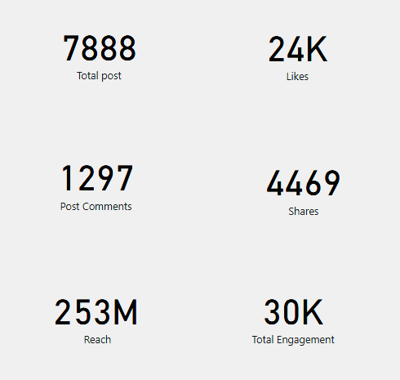
Key Drivers
Top Influencers
ShivaniV2901
GreenTea_India
OrganicLiveFood
theliverdr
Sachkahoon
sfacindia
WhoDFisAlice
RujutaDiwekar
vivekagnihotri
Fact

Slide 26
Devices used

Slide 27
Methodology
To prepare this report, data was thoroughly examined and non-relevant and junk data was eliminated.
There were comma separated columns and to separate them and convert them into row, power pivot was used.
Advance Excel technique were used to prepare calculative data for the report such as pivot table and vlookup.
To perform sentimental analysis date and time was segregated and date column and sentiment column was used in pivot table and this data was used to generate visual.
To generate key trends, date column and post column was used in the pivot table to generate visual for the same.
To generate top brands and flavours, hashtag column was used to determine brands and flavour spoken in the conversation and appropriate Sov was used.
To derive key metrics, Power bi was used to develop cards consisting data for shares, impression and engagement. For top influencers, mention column was used.
In order to analyse the brand, key drivers for each of the brand was thoroughly examined and sentiment was also compared and analysed for the same.
To generate top themes, hashtags consisting commas were separated. Power pivot was used to determine top keyword used in the conversation.

Slide 28
summary
Spike in the post was observed in the month of 4th August because of 368 post regarding Dabur honey-green tea conservation was tracked. Second highest conversation was observed on 10th June because of the comment from Guru Gurmeet Ram Rahim regarding obesity.
There were 7888 post in which 24k likes, 1297 comments, and 4469 shares
People across the social media platform spoke positive about brands ie 64%, followed by 7% negative and 29% neutral.
On 4th August, there was spike in media coverage because of the post regarding Dabur honey which occurred 368 times on that particular day.
21st May had maximum positive sentiment while 24th September had least positive. 21st May was observed as International Tea Day which led to rise in the positive conversation on that particular day.
Most neutral sentiment was observed on 10th June and least neutral was observed on 29th September.
Meanwhile maximum negative sentiment was 30th May and least negative was July. There was critism for information about reducing fat through green tea.
Green tea was the most commonly used keyword in the conversation
Leafbox has highest brand which was mentioned followed by Tetley and Lipton.
People spoke more about Darjeeling green tea and least preferred was turmeric green tea.
Most people used twitter android to interact. 78% are male, 22% female who interacts in social media.
Most of the people interacted from India and compared to other countries and New Delhi ranked most engaging users across social media platform.

Slide 29
Conclusion
From the analysis we can conclude that Tetley which is owned by Tata FCMG has second highest brand mention compared with Leafbox. Tetley has more followers as compared to Leafbox and Leafbox has highest engagement rate as compared to other brand. Whereas Tetley has greater proportion of impression and reach compared to Leafbox.
Leafbox has focussed more on engagement( used more hashtags and spoke about flavours and health benefits) and have targeted more into text based post as compared to URL based post. Leafbox has 100% positive sentiment post as compared to other brands.
Most of the people have spoken positive about green tea such as health benefit, tea party celebration, lifestyle.
But small proportion of people doesn’t believe in the health benefit and they do not have trust on consuming green tea. Hence there is necessity to educate those proportion of people with the help of scientific health fact.
Suggestion :
In order to get more brand mention from consumers, Tetley need to focus on more engaging post such as text based post or images or video based post which helps in getting good engagement and reach. Using more hashtags in the post will help to get more engagement.
Speaking about herbal ingredients and health benefit will help to get more engagement for such post.
Collaborating with influencer can also help to reach post towards audience.

